Slide 1
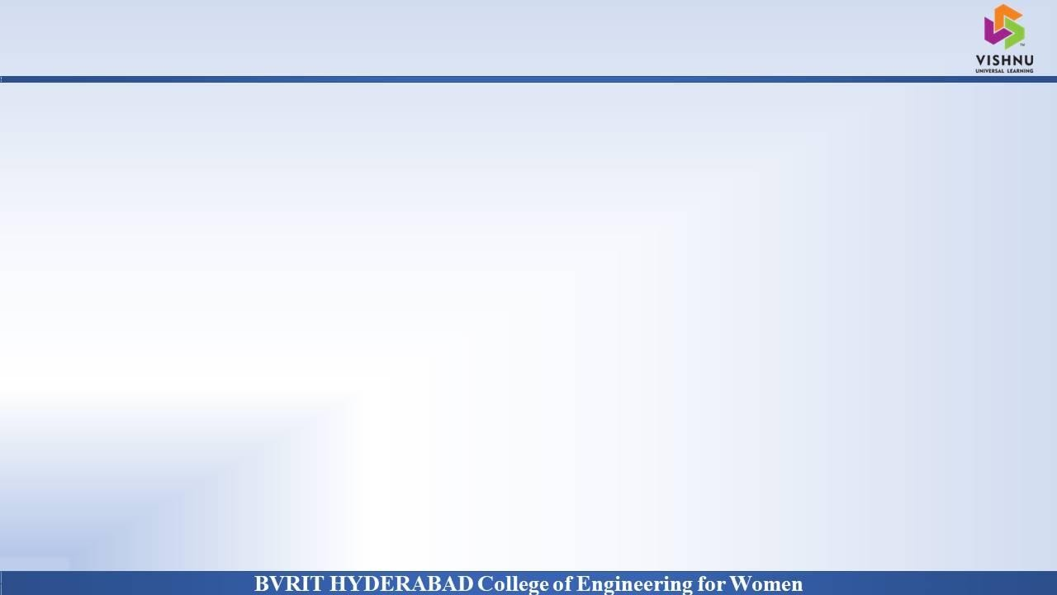
Department of Computer Science and Engineering
OBJECT DETECTION AND ALERT SYSTEM
FOR VISUALLY IMPAIRED PEOPLE
Date: 28 May 2021
KURA PRAVALLIKA : 17WH1A0525
THOTA SAHITHI : 17WH1A0539
PALEPU PRIYOOSHA : 17WH1A0559
Internal Guide: Mr. M DYVA SUGNANA RAO
Designation: Assistant Professor

Slide 2


Abstract
Why Should I Study this course?
Examples
BVRIT HYDERABAD College of Engineering for Women
Problem Statement:
Good vision is a precious gift but unfortunately loss of vision is becoming common nowadays. To help the blind people, the visual world has to be transformed into the audio world with the potential to inform them about objects as well as their spatial locations.
Project Objective:
Many people suffer from partial or complete blindness in this world. The main objective revolves around implementing object detection with an alert system and embedding it into an app which is blind friendly. Our project aims at helping people who are visually impaired or with their navigation.

Slide 3
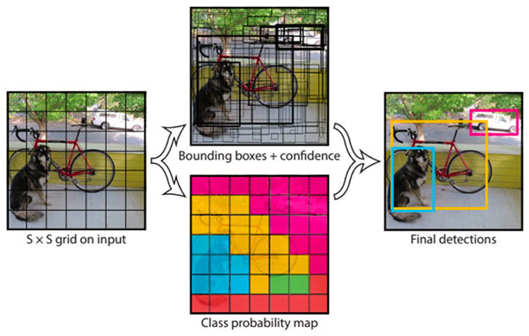
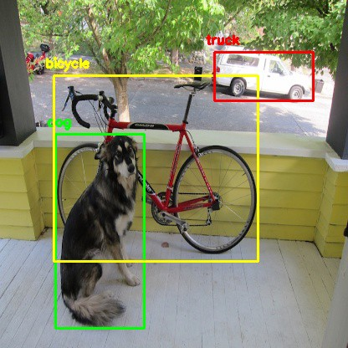
Dataset
Why Should I Study this course?
Examples
BVRIT HYDERABAD College of Engineering for Women
Dataset Description:
We take images and train the Yolo model to recognize them and transform it into audio.

Slide 4
Architecture
Why Should I Study this course?
Examples
BVRIT HYDERABAD College of Engineering for Women
Object
Recognition
Image Classification
Object Localization
Object Detection
Audio Output
Notes:
4

Slide 5

Technology Stack
Why Should I Study this course?
Examples
BVRIT HYDERABAD College of Engineering for Women
Python
HTML
CSS
Visual Studio code
Text-to-Speech Engine
Packages Used:
Matplotlib
Opencv
Torch
Audio Output gTTS – Google Text-To-Speech Python Library

Slide 6
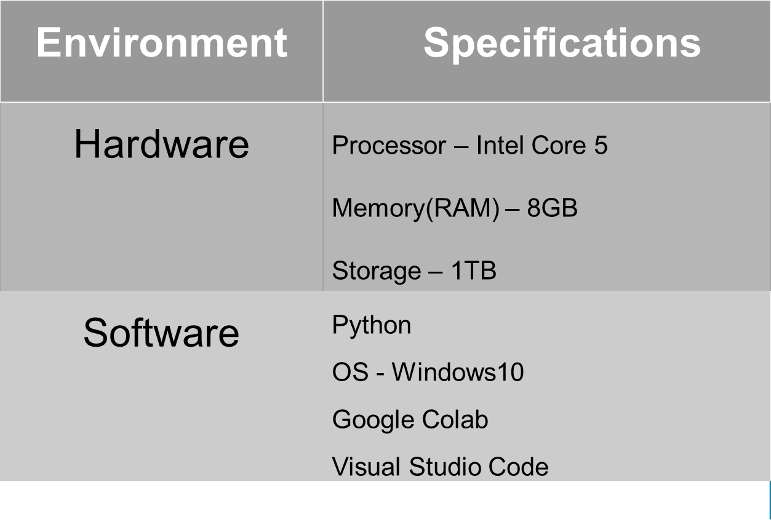
System Requirements
Why Should I Study this course?
Examples
BVRIT HYDERABAD College of Engineering for Women

Slide 7
COMPARISON
Why Should I Study this course?
Examples
BVRIT HYDERABAD College of Engineering for Women
 | YOLO | YOLO v2 | YOLO v3
Input size | 224 x 224 | 448 x 448 | 416 x 416
Framework | Darknet trained on ImageNet—1,000. | Darknet-19 19 convolution layers and 5 max pool layers. | Darknet-53 53 convolutional layers. For detection, 53 more layers are added, giving a total of 106 layers.
Small size detection | It cannot find small images. | Better than YOLO at detecting small images | Better than YOLO v2 at small image detection.

Slide 8

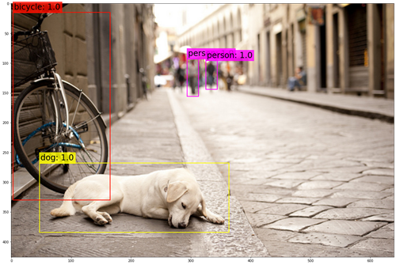
TEST CASES
Why Should I Study this course?
Examples
BVRIT HYDERABAD College of Engineering for Women
Test case input
Test case output
1. dog: 0.999024
2. bicycle: 0.999822
3. person: 1.000000
4. person: 1.000000

Slide 9
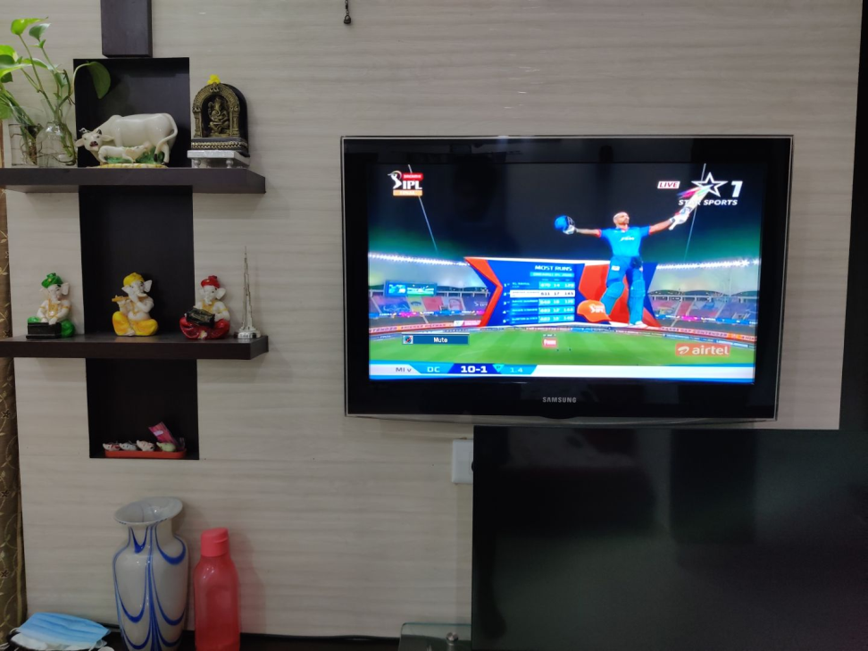
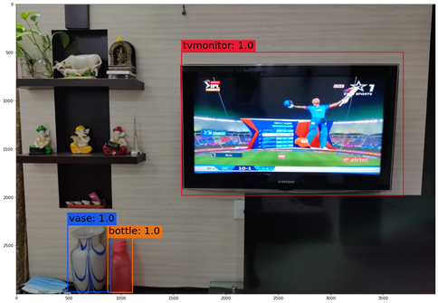
Why Should I Study this course?
Examples
BVRIT HYDERABAD College of Engineering for Women
Test case input
Test case output
1. tv/monitor: 0.999921
2. bottle: 0.994491
3. vase: 0.999943

Slide 10

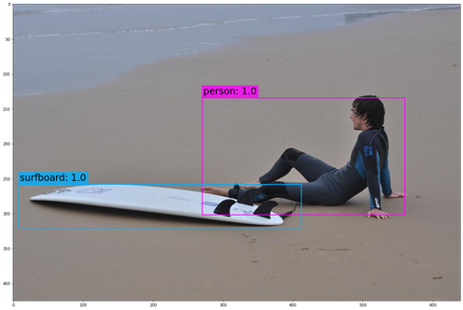
Why Should I Study this course?
Examples
BVRIT HYDERABAD College of Engineering for Women
Test case input
Test case output
1. person: 1.000000
2. surfboard: 0.994814

Slide 11
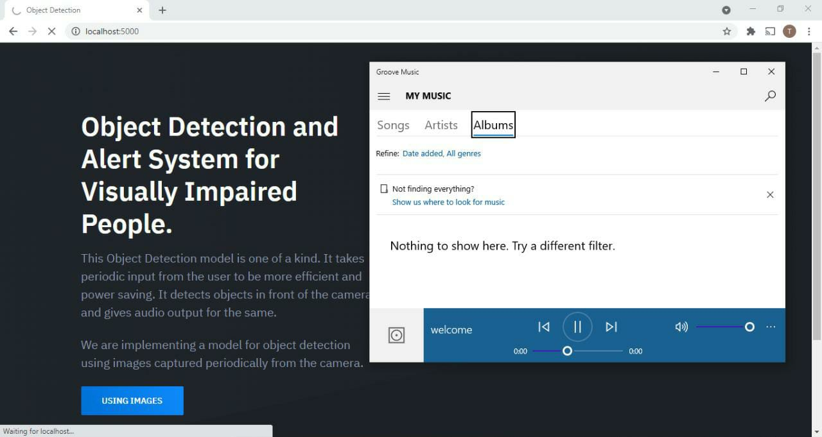
OUTPUT
Why Should I Study this course?
Examples
BVRIT HYDERABAD College of Engineering for Women
Object detection and audio output

Slide 12
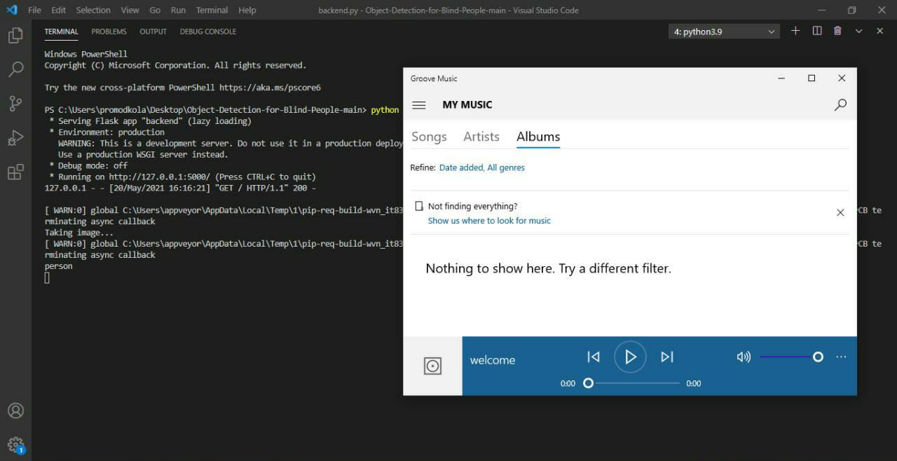
Why Should I Study this course?
Examples
BVRIT HYDERABAD College of Engineering for Women
Object detection and audio output in Visual Studio Code

Slide 13
Timeline
Why Should I Study this course?
Examples
BVRIT HYDERABAD College of Engineering for Women
Review 0 | Abstract Base paper and References
Review 1 | Software Requirements Specifications Architecture Base paper and References
Review 2 | Review-1 slides Partial implementation of features
Review 3 | Complete implementation Results & Discussions
 | Report of the Project

Slide 14
[1] Base paper:
https://openaccess.thecvf.com/content_cvpr_2016/html/Redmon_You_Only_Look_CVPR_2016_paper.html
[2] Reference papers:
https://portal.unifiedpatents.com/patents/patent/US-8803699-B2
https://patents.google.com/patent/US9064172
References
Why Should I Study this course?
Examples
BVRIT HYDERABAD College of Engineering for Women

Slide 15
Thank you

